Slide 1
VM Props Formatter
27 Apr 2020
Data Science Team
Fiona Tan

Slide 2
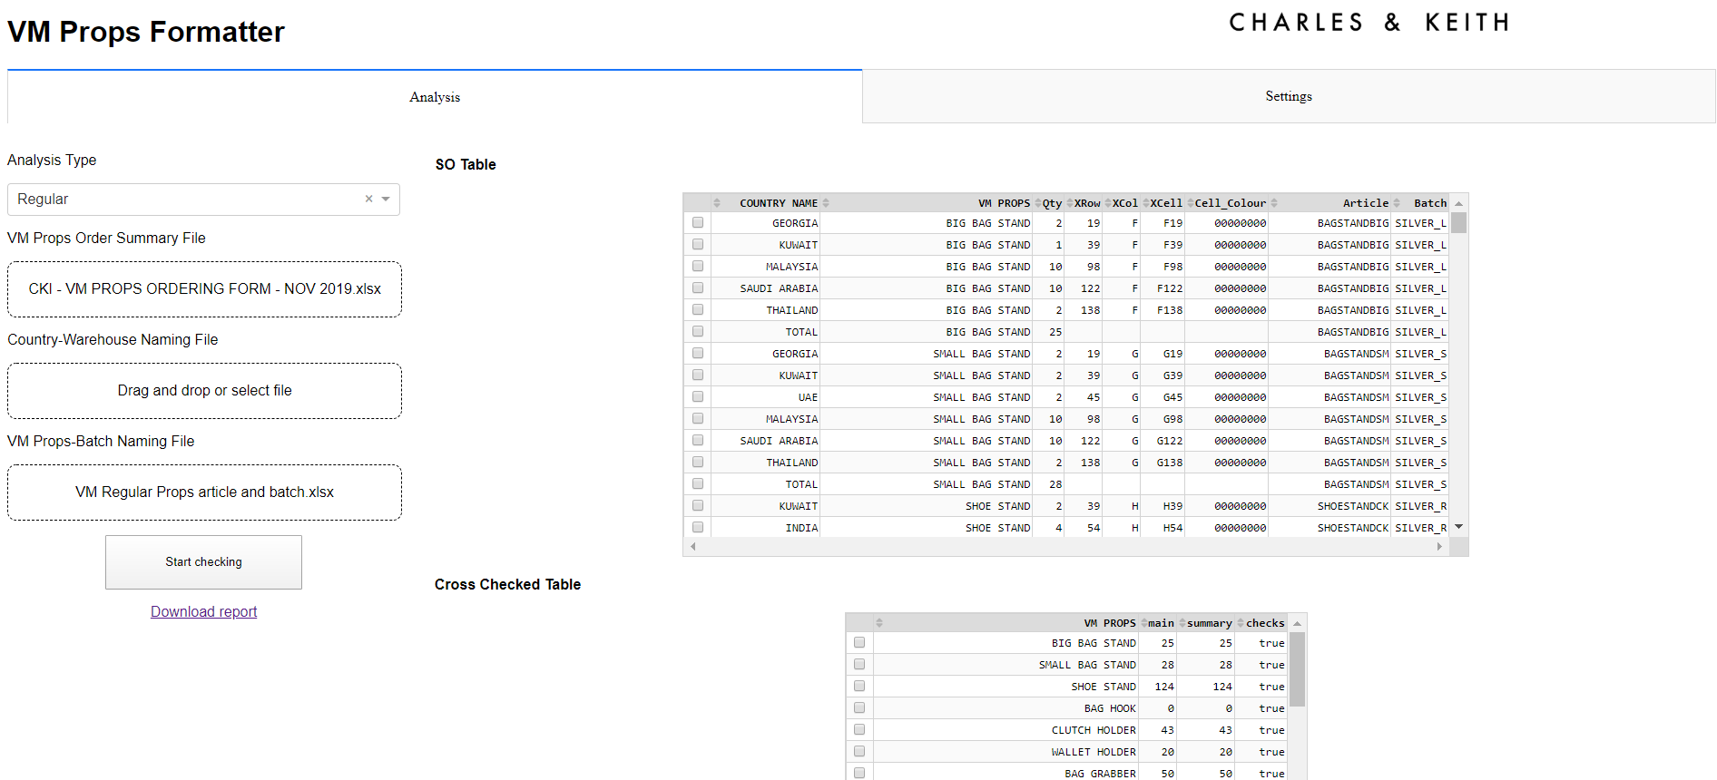
VM Props Formatter App is a Python library that helps convert VM Props Order Form into SO format. The app includes customizable rendering of table shapes and detection of cell colors.

Slide 3
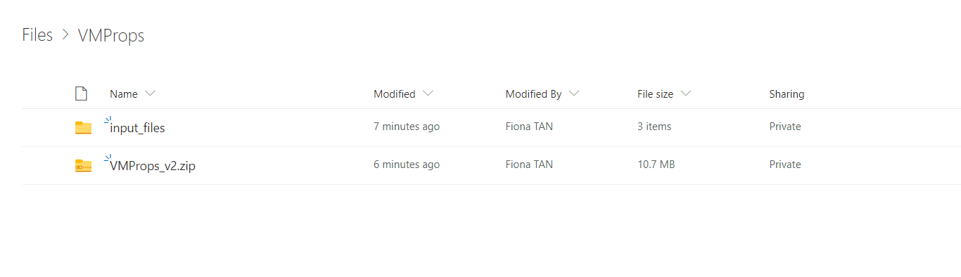
Usage
This app currently supports both Regular and Seasonal Props files.
Local deployment (Users are taught to copy the folder into their local desktops and hit on ‘run_app’ Batch File after ‘install_libraries’)
Please refer to email for more information on user-side installation.

Slide 4
Prerequisites
Download the zipped file from OneDrive.
Please install the required Python packages by running this command or using Shell:
pip install -r requirements.txt

Slide 5
Input Requirements
Data is uploaded by users into the boxes on UI. Excel files are read and processed
Supports only XLSX files

Slide 6
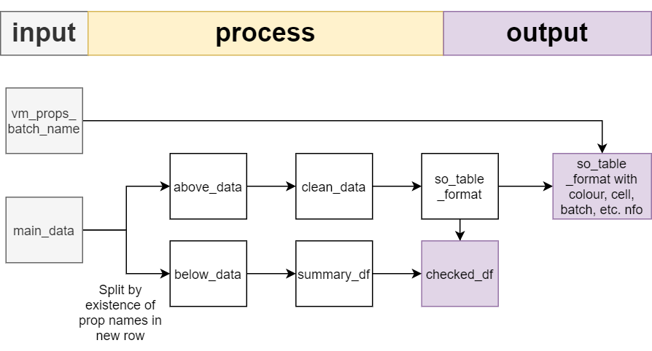

Slide 7
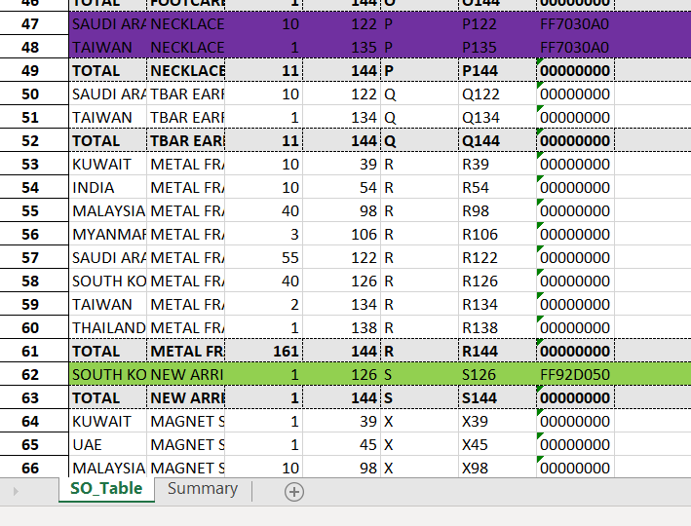
Frontend Output
Only shows on second click

Slide 8
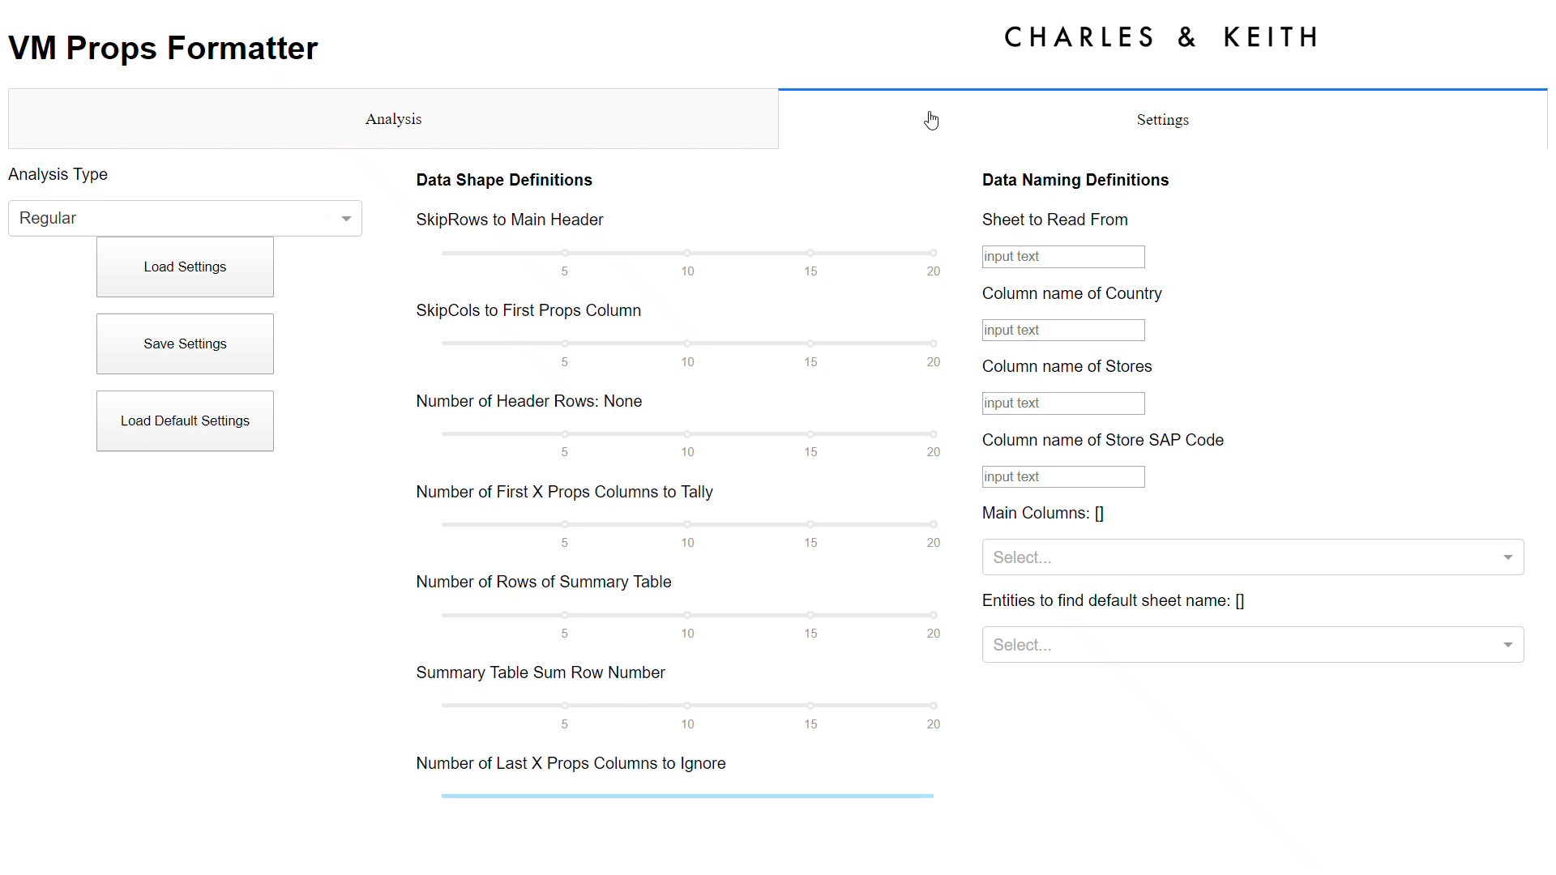
Interface

